Slide 1


Life of Pi
Dr. Barnali Chetia

Slide 2
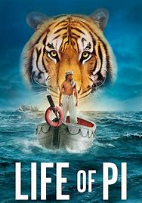

Slide 3
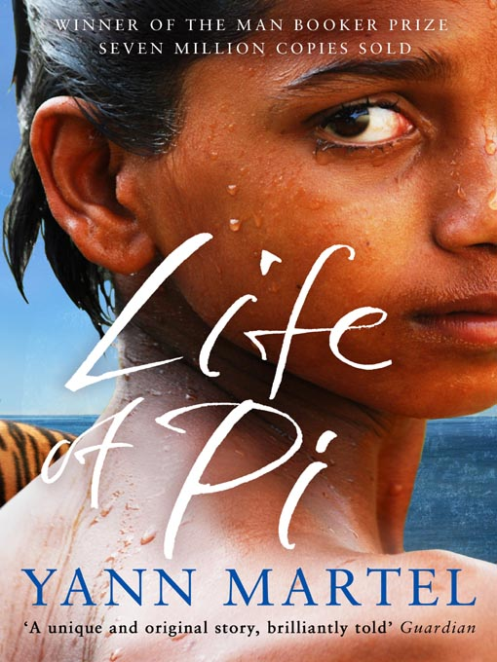

Slide 4
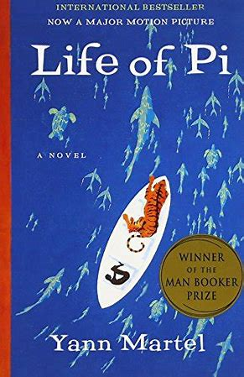

Slide 5
Overview
Type Of Work Novel
Genre Allegory; fable
Language English
Time And Place Written Researched in India and Canada and written in Canada in the late 1990s
Date Of First Publication 2002
Publisher Canongate Books Ltd.
Narrator Piscine Molitor Patel and the author, Yann Martel

Slide 6
Overview
Point Of View -The prefatory Author’s Note is written in first person by the author, who explains how he came to hear the story we are about to read from Pi Patel himself.
-The account (Part One and Part Two) is told in first person by Pi.
-The final section of the book (Part Three) is written mainly as a transcript of a conversation between Pi
and two officials, book ended by first-person comments from the author.
Tone Funny, surreal, ruminative, philosophical, and, at times, journalistic
Tense Past tense
Setting (Time) The author tells Pi’s story from an undetermined contemporary point, some years after the publication of his second book in 1996. Pi’s ordeal begins on July 2, 1977, and continues for 227 days.
Setting (Place) Pi’s boyhood home in Pondicherry, India; the Pacific Ocean; Tomatlán, Mexico; and, briefly, Toronto, Canada

Slide 7
Overview
Protagonist -Piscine Molitor Patel
Major Conflict - The Tsimtsum sinks, drowning Pi’s entire family, the crew, and most of the animals aboard. For months, Pi, along with a Royal Bengal tiger, must fight for survival aboard a lifeboat in the middle of the Pacific Ocean
Rising Action - The Patel family sets sail to Canada.
Climax -The first climax is when the Tsimstum sinks and Pi’s family dies, leaving him alone with wild animals on a lifeboat. Another climax occurs when Pi lands in Mexico.

Slide 8
Overview
Falling Action -Pi is rescued in Mexico. Two Japanese officials interview him. His story is called into doubt.
Themes -The power of life’s force; the human desire for companionship; storytelling as a strategy for self-preservation
Motifs -Territorial dominance; hunger and thirst; rituals
Symbols- Pi, the lifeboat, Richard Parker, the colour orange

Slide 9
Overview
Foreshadowing The opening pages of the book are supremely suspenseful, as the author and Pi himself continually make reference to some tragic episode in Pi’s life without actually naming it.
Pi describes his gloomy state of mind upon arriving in Canada and explains how his religious and zoological studies helped him to rebuild his life.
But it is not until the Tsimtsum sinks in Part Two and Pi loses his family that we understand the source of his intense suffering, though we do sense it coming all along.

Slide 10
Summary
Life of Pi is a fantasy adventure novel by Yann Martel published in 2001.
The protagonist, Piscine Molitor "Pi" Patel, a Tamil boy from Pondicherry, explores issues of spirituality and practicality from an early age.
He survives 227 days after a shipwreck while stranded on a boat in the Pacific Ocean with a Bengal tiger named Richard Parker.
The novel has sold more than ten million copies worldwide. It was rejected by at least five London publishing houses before being accepted by Knopf Canada, which published it in September 2001.
The UK edition won the Man Booker Prize for Fiction the following year. It was also chosen for CBC Radio's Canada Reads 2003, where it was championed by author Nancy Lee.

Slide 11
The French translation L'Histoire de Pi was chosen in the French CBC version of the contest Le combat des livres, where it was championed by Louise Forestier.
The novel won the 2003 Boeke Prize, a South African novel award. In 2004, it won the Asian/Pacific American Award for Literature in Best Adult Fiction for years 2001–2003.
In 2012 it was adapted into a feature film directed by Ang Lee with a screenplay by David Magee.

Slide 12
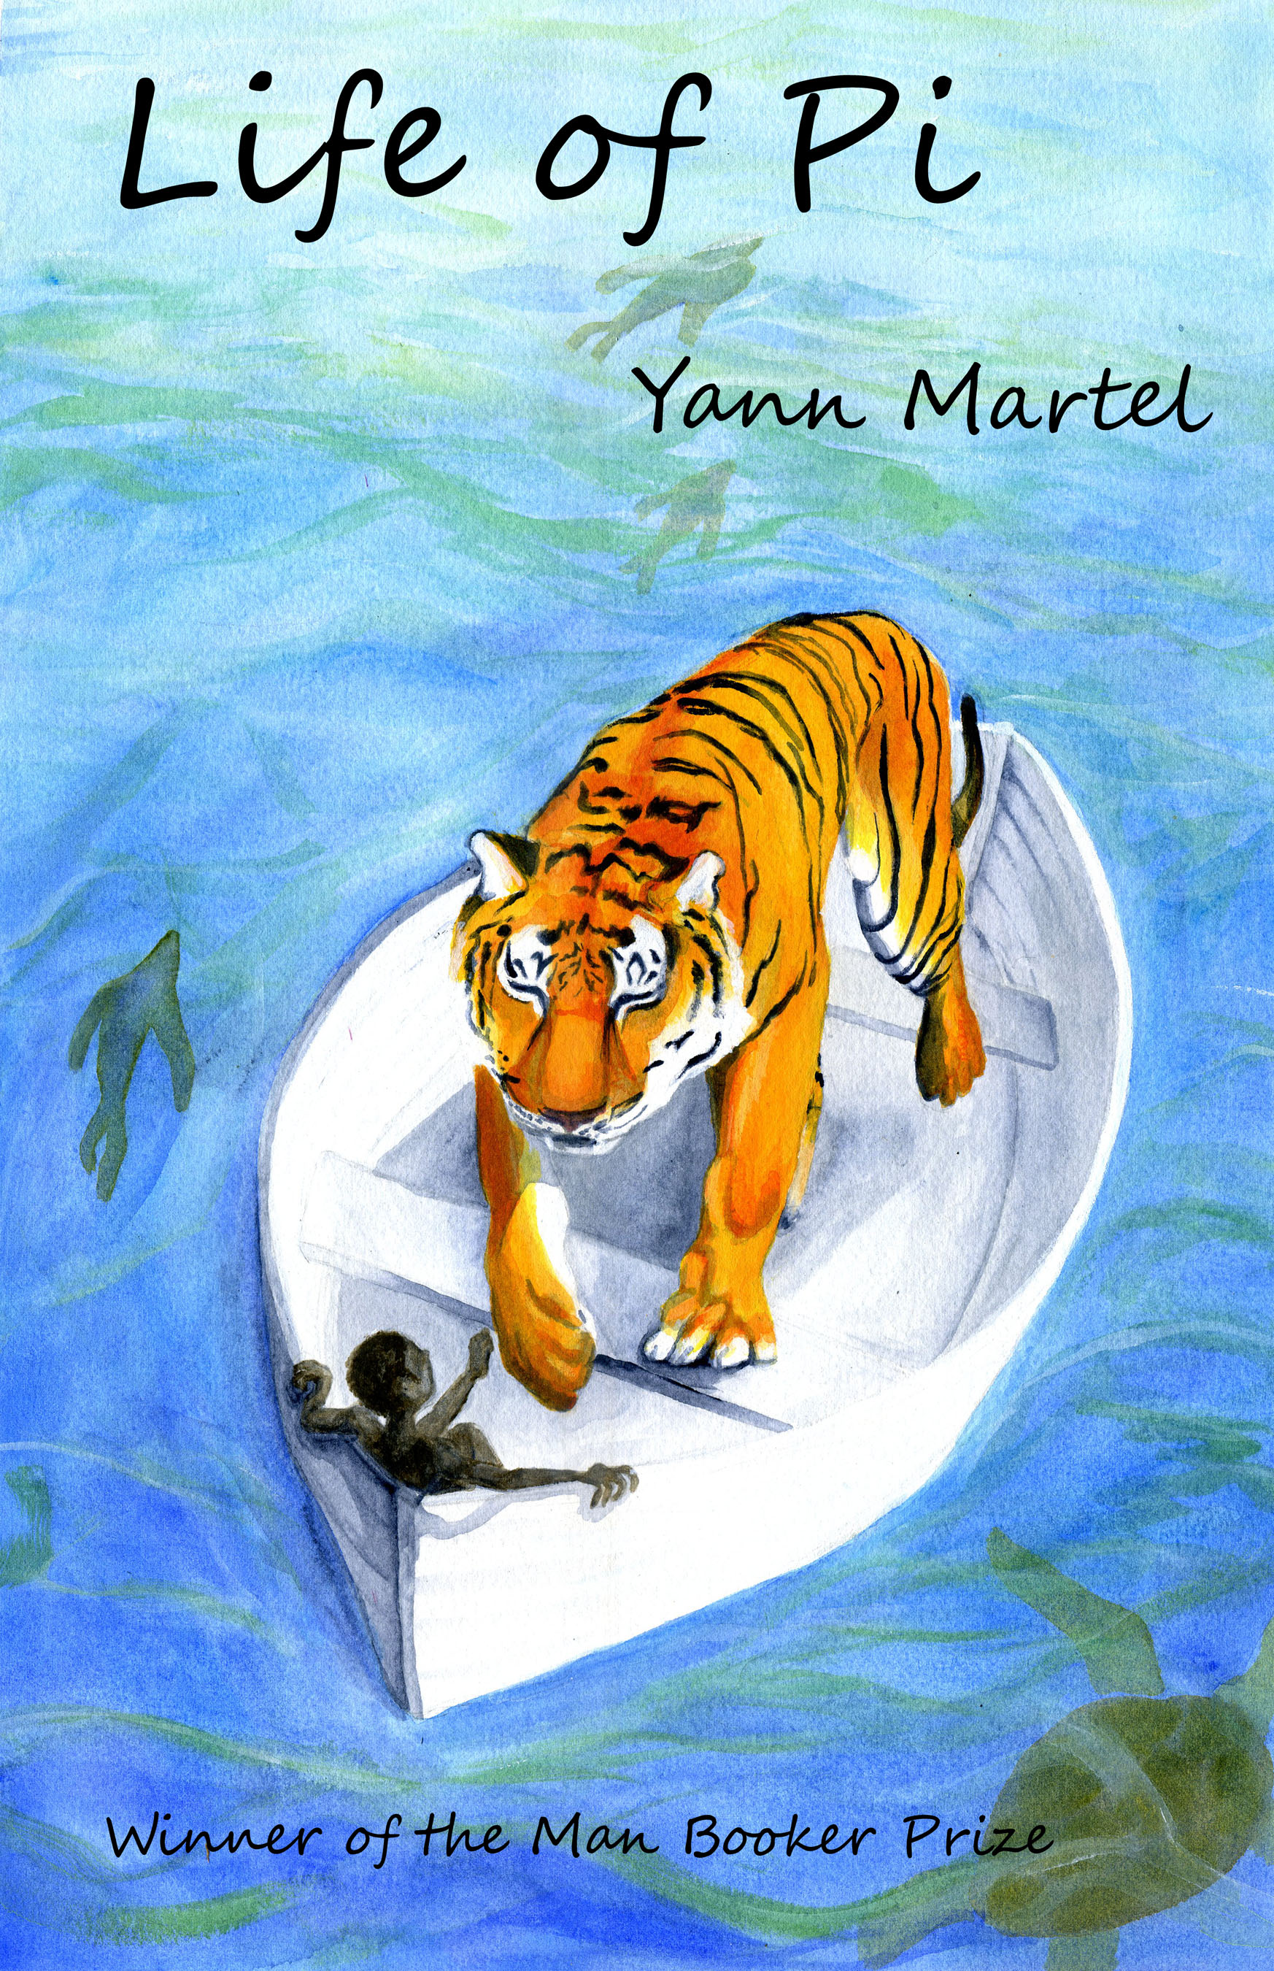

Slide 13
Central Theme
The central theme of Yann Martel’s Life of Pi concerns religion and human faith in God.
The novel pointedly refrains from advocating any single religious faith over another. Instead, the novel investigates the nature of religious faith itself.
This theme is embodied most clearly in the novel’s protagonist, Pi Patel, who is a devout follower of three very different religions.
Pi has studied and memorized the stories of all the various incarnations of the Hindu Gods, maintaining shrines in his home to many of them.

Slide 14
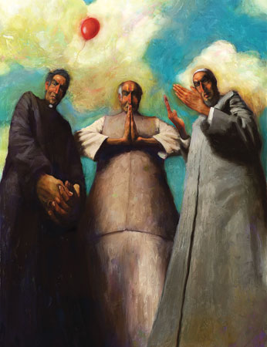

Slide 15
He also possesses a crucifix and a rosary, going to church on Sundays and praying to Jesus.
Lastly, he owns and proudly uses a prayer rug, observing the call to prayer several times a day as a devoted Muslim.
By comfortably following three of the world’s major religions, Pi represents not just the possibility of peaceful coexistence between different faiths but also the belief that different religions are merely alternative paths to the same destination.

Slide 16
The specific doctrines of Pi’s three faiths make very little difference to him.
When comparing these religions to one another, Pi seems to conclude in his innocence that there need not be conflict between them.
For him, each religion simply emphasizes what is most powerful and true in the others according to its own strengths.
The religions resemble different chapters of one very long book, each chapter setting up and feeding into the next.
The novel contrasts Pi’s easy acceptance of his three faiths with the competition and arguments between the leaders of those faiths.

Slide 17
In Munnar, while Pi is walking in a busy marketplace with his parents, they happen upon the pandit, imam, and priest who are the leaders of Pi’s Hindu, Muslim, and Christian faiths, respectively.
When the leaders discover that Pi has been following three different religions, each attempts to claim Pi for himself.
They reason that one boy cannot follow three different paths, and they begin to debate which religion would be best for Pi.
When the leaders demand that Pi choose one faith to the exclusion of all others, he blurts out, “I just want to love God,” embarrassing the hot-headed religious leaders and putting a stop to their debate.

Slide 18
This tension between reason, logic, and argument, on one hand, and simple religious faith and the desire to love God, on the other hand, lies at the novel’s core.
The human capacity for reason is contrasted to religious faith repeatedly, nowhere more poignantly than in the chapters showing
- Pi adrift on the Pacific Ocean, where his faith, not his reason, enables Pi to survive: I was alone and orphaned in the middle of the Pacific hanging onto an oar, an adult tiger in front of me, sharks beneath me, a storm raging about me. Had I considered my prospects in the light of reason, I surely would have given up and let go of the oar, hoping that I might drown before being eaten.

Slide 19
Pi’s refusal to consider his predicament “in the light of reason” opens up space for his faith in God to flourish, and this faith sustains him even through the darkest, most fearful moments.
Fear, Pi realizes, is “life’s only true opponent,” and he holds back the fear with his faith, no matter what religion embodies that faith.

Slide 20
The novel also explores another meaning of faith—the human capacity to believe what is unbelievable. Pi’s story challenges readers with plot twists that sound impossible.
That Pi survives 227 days adrift on a lifeboat in the Pacific Ocean is remarkable enough
-that he survives this time in the company of a Bengal tiger or that he happens to run into a floating island of carnivorous algae strains readers’ ability to suspend their disbelief.

Slide 21
A skeptical attitude towards the narrative is embodied by Mr. Okamoto and Mr. Chiba, who at first refuse to believe Pi’s stories about a Bengal tiger and carnivorous algae.
They insist that his story contradicts reality, to which Pi replies
- “You want a story that won’t surprise you. That will confirm what you already know. That won’t make you see higher or further or differently. You want a flat story.”

Slide 22
Symbolism
Pi
Piscine Molitor Patel’s preferred moniker is more than just a shortened version of his given name.
Indeed, the word Pi carries a host of relevant associations.
It is a letter in the Greek alphabet that also contains alpha and omega, terms used in the book to denote dominant and submissive creatures.
Pi is also an irrational mathematical number, used to calculate distance in a circle.

Slide 23
Often shortened to 3.14, pi has so many decimal places that the human mind can’t accurately comprehend
Just as, the book argues, some realities are too difficult or troubling to face.
These associations establish the character Pi as more than just a realistic protagonist
He also is an allegorical figure with multiple layers of meaning.

Slide 24
The Color Orange
In Life of Pi, the color orange symbolizes hope and survival.
Just before the scene in which the Tsimtsum sinks, the narrator describes visiting the adult Pi at his home in Canada and meeting his family.
Pi’s daughter, Usha, carries an orange cat.
This moment assures the reader that the end of the story, if not happy, will not be a complete tragedy
- since Pi is guaranteed to survive the catastrophe and father children of his own.

Slide 25
The little orange cat recalls the big orange cat, Richard Parker, who helps Pi survive during his 227 days at sea.
As the Tsimtsum sinks, Chinese crewmen give Pi a lifejacket with an orange whistle; on the boat, he finds an orange lifebuoy.
The whistle, buoy, and tiger all help Pi survive, just as Orange Juice the orangutan provides a measure of emotional support that helps the boy maintain hope in the face of horrific tragedy.

Slide 26
Truth-Version
When Pi gives them the flat story they want, a story that fails to contradict what they are prepared to believe, the men become excited by the prospect that this second version is the truth.
However, Pi is not finished with them or their skepticism.
He demonstrates that the facts of both stories are irrelevant to the men’s purpose of finding out what caused the Tsimtsum to sink, and he points out that the men are in a position to verify neither of the two versions.

Slide 27
Then, he asks-
“Which is the better story, the story with animals or the story without animals?” The men agree that the story with animals is superior, which prompts Pi to add, “And so it goes with God.” This is faith, Pi seems to say.
Since it is the nature of religious faith that it can never be proven, just as the facts of Pi’s journey across the Pacific can never be verified
- the question is not a matter of reason but of belief.
Pi seems to argue that what should compel one to believe a story is whether the story is a good one—whether it helps readers “see higher or further or differently.”

Slide 28
Life of Pi Themes
The main themes in Life of Pi are truth, stories, and the relationship between animals and humans.
Truth: Pi continually seeks truth as he studies religion and science and redefines his identity following his traumatic experience in the lifeboat.
Stories: stories are used to make sense of life in both the religious stories that Pi studies and in the two versions he presents of what happened following the sinking of the ship.
Animals and humans: Much like the animals that assert themselves relative to their environment, Pi learns to adapt to new circumstances. Pi sees connections between animals, humans, and religious myth.

Slide 29
The quest for the meaning of life
All throughout Life of Pi, characters are seeking the meaning of life. The primary seeker for this profound truth is, of course, Pi himself. As the first chapter notes, as an adult Pi studies both science (zoology specifically) and religion at colleges. These interests are both the natural extension of how Pi passed his time while he was a boy: he was the son of a zookeeper but also a devotee of several religions, seeking direct knowledge of God from an early age. Both practices seek to understand the mysteries of human existence.

Slide 30
The centrality of stories in making sense of life
In Life of Pi, the question "Who am I?" is answered by a story: the story of a name. Pi's identity changes many times, beginning with the story of his name.
As Pi himself says at the start of Chapter 5, "My name isn't the end of the story about my name."
When he shortens his name from "Piscine" with the many jokes made about "Pissing" to "Pi," he has freed himself from the societal bondage.

Slide 31
When Pi encountered the Christian God, he was troubled not just by the content of the story the Christians told but also by the fact that there was only one core story, told again and again.
When Pi was lost at sea, he told and retold the story of what was happening to him, trying to make sense of it.
These stories took quite different forms.

Slide 32
Finally, the story of what happened after the boat sank determines the meaning of Pi's entire life.
The two Japanese officials inquiring in the fate of the Tsimtsum quizzed him about his actual story.
They did not believe it, challenging it at many points, especially about the idea of a cannibalistic island. Because they challenged Pi's story, readers do too.
We are left with not one but two possible stories of what happened.

Slide 33
Historical Context The War on Terrorism
In late 2002, America, only one year removed from the September 11 attacks, had just defeated the Taliban in Afghanistan but was deeply divided over the impending war in Iraq. At a time of continued anxiety over possible attacks from al Qaeda and other Muslim terrorists, Americans were increasingly curious about Islam.
Many struggled to understand why many Muslims hated America and why the al Qaeda airplane hijackers were driven to kill otherwise innocent Americans.

Slide 34
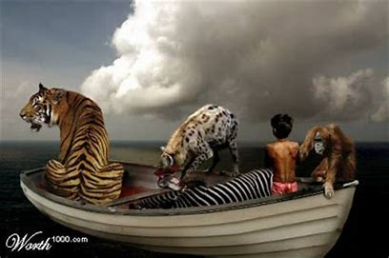

Slide 35
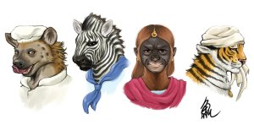

Slide 36
Many Americans saw the need to deal with, and perhaps make peace with, Muslims after the carnage that al Qaeda had wrought on the United States.
However, books such as Samuel Huntington's The Clash of Civilizations (1996, Simon & Schuster) asserted Christian and Islamic cultures were absolutely opposed and could not peacefully coexist.
As an earnest practitioner of Christianity Islam and Hinduism who saw no conflict between these three beliefs, Pi became a symbol of how the major religions of the world could coexist and that they in fact shared many common features.
Pi’s reconciliation of three different faiths stood in sharp contrast to the violence between Christian and Muslim people that was evident both in America and in the Middle East.

Slide 37
In the decades before the issue of a possible clash between Muslim and Christian cultures arose, growing numbers of Americans had also become less attached to specific churches while still affirming a belief in God and seeking to pursue a religious path. In an interview with The Sunday Telegraph (London) shortly after receiving the Man Booker Prize, Martel said his novel “will make you believe in God or ask
yourself why you don’t.” Pi
, a believer who does not choose between the various visions of God offered by the world's different religions, offered American readers a way to explore faith and spirituality without having to follow any specific creed or tradition.
In the decades before the issue of a possible clash between Muslim and Christian cultures arose, growing numbers of Americans had also become less attached to specific churches while still affirming a belief in God and seeking to pursue a religious path. In an interview with The Sunday Telegraph (London) shortly after receiving the Man Booker Prize, Martel said his novel “will make you believe in God or ask yourself why you don’t.” Pi, a believer who does not choose between the various visions of God offered by the world's different religions, offered American readers a way to explore faith and spirituality without having to follow any specific creed or tradition.

Slide 38
Indian History and Culture
India has a long history of hostility between Muslims and Hindus.
Soon after the country gained independence from Great Britain in 1947, it embarked on a civil war, which resulted in the partitioning of Pakistan from India as a homeland for the nation’s Muslims.
However, clashes over Kashmir, a land in northern India claimed by both India and Pakistan, continued to haunt the region throughout the rest of the 1900s.
The conflict led both countries to test nuclear weapons in 1998, and skirmishes on the border nearly brought the countries to war in 1999.

Slide 39
Murderous riots and persecution by Muslims and Hindus have also plagued India for decades, including, in February and March 2002, riots in the Hindu nationalist state of Gujarat.
In those riots, Hindus were angered over a fire that killed roughly sixty Hindu pilgrims on a train, and they responded by accusing Muslims of setting the fire.
Hundreds of Muslims were killed by angry Hindu rioters.
Pi is a native of Pondicherry, India, but he displays none of the hatred that had inspired thousands of Indian Muslims and Hindus to kill each other in the fifty-five years between India’s independence and the U.S. publication of Martel’s book.

Slide 40
Analysis
“In Life of Pi we have chosen an audacious book in which inventiveness explores belief,” said Lisa Jardine, chair of the committee which selected Yann Martel’s novel for the 2002 Man Booker Prize, Britain’s most publicized and arguably most prestigious literary award.
The choice was surprising given the competition; the shortlist comprised Sarah Waters, Tim Winton, the venerable William Trevor, and three Canadians: Carol Shields, dying of breast cancer; Rohinton Mistry, all three of whose novels have been shortlisted for the Booker, and Martel.
Although the dark horse, Life of Pi was much admired by reviewers, including fellow Canadian and former Booker winner Margaret Atwood: “a terrific book . . . fresh, original, smart, devious, and crammed with absorbing lore . . . a far-fetched story you can’t quite swallow whole, but can’t dismiss outright.”

Slide 41
The power of Martel’s novel may be gauged by how well it survived a tabloid-style attack, following the Man Booker ceremony, for not being original enough, borrowing too freely from an obscure 1956 Brazilian novel, Moacyr Scliar’s Max and the Cats.
Set in 1933, Scliar’s novel concerns a young Jew who, fleeing Nazi Germany, survives shipwreck by sharing a lifeboat with a panther.
That Martel acknowledges Scliar’s novel in his “Author’s Note” as having provided the “spark of life” to Life of Pi hardly mattered, least of all at a time when accusations of plagiarism in high places (against historians Stephen Ambrose and Doris Kearns Goodwin) and the debate over intellectual property rights in the global economy were all the rage.

Slide 42
Martel’s “Author’s Note,” a playful mélange of fact and fantasy (the “author” here is and is not Martel), puts the novel in a more autobiographical context.
Born in Spain to French Canadian parents (his father a diplomat and poet), the well-traveled Martel grew up wherever his father was posted.
After studying philosophy at Trent University in Peterborough, Ontario, he published a collection of short stories, The Facts Behind the Helsinki Roccamantos (1993), and a novel, Self (1996). Both received good notices but were commercially unsuccessful.

Slide 43
Martel went to India where, depending on whether one believes the author or the “Author’s Note,” one (or both) of two things happened.
Either the writer who had planned to write a novel set in Portugal in 1939 suffered writer’s block until he ran into an elderly man, Mr. Adirubaswamy, who told him “a story that will make you believe in God,”
- the story that became Life of Pi, or the writer, this time speaking ex cathedra rather than from
within the factoidal “Author’s Note,” had a vision.

Slide 44
The north Indian plain before him became in his imagination an ocean with a lone lifeboat floating upon it.
He began researching his novel while still in India, visiting zoos in the south, then returned to Canada where he read extensively in zoology and animal psychology, Hinduism, Christianity, and Islam; he even started attending Catholic mass.
Over the course of writing his novel, he became what his protagonist is, a believer, albeit a believer of an odd and oddly inviting kind.

Slide 45
That protagonist is Piscine Molitor Patel, from Pondicherry, a former French colonial city that is now part of the modern Indian state of Tamil Nadu. Named for a Parisian swimming pool but later saddled with the moniker Pissing Patel by a classmate, he reinvents himself as Pi.
“And so, in that Greek letter that looks like a shack with a corrugated roof, in that elusive irrational number with which scientists try to understand the universe, I found refuge.”
The son of secularized parents (as is Martel), Pi becomes as enamored of religion (or religions) as he is of science, but when priest, pandit, and imam each tries to claim him as his own, as his atheist science teacher previously tried, Pi balks, critical of their small-mindedness.
When a short time later Prime Minister Indira Gandhi, proving similarly small-minded and territorial, brings down the local government, Pi’s father, owner of the local zoo, decides that the family will immigrate to Canada.

Slide 46
On July 2, 1977, just eleven days after leaving Madras, the ship goes down. After 277 days in a 26-foot lifeboat, Pi and Richard Parker, a 450 pound Bengal tiger, arrive in Mexico, the sole survivors.
At first, however, the lifeboat is a bit more crowded, its “ecosystem” more complex. The hyena eats the zebra and then the orangutan, before being eaten in turn by Richard Parker, who does not eat Pi. That he does not is as improbable as the tiger’s name, only more ambiguously explained.
The simple explanation is that Pi, the zookeeper’s son, manages to master the beast. However, nothing is ever quite so simple in this artful fable, in which simplicity is invariably a means, not an end in itself. Man (or boy) and tiger, Pi and Parker, become dependent on each other: the tiger on Pi for food and water, Pi on the tiger for a strange kind of companionship that is as much spiritual as psychological.

Slide 47
Pi’s “I” is omnipresent but unpretentious in this not-quite-first-person story-within-a-story of a novel, and it is his voice that delights and beguiles. At times he sounds like a fortune cookie, at others like a mini-Salman Rushdie, practicing an art of restrained excess.
The humor is all the more effective for being understated and the despair made more poignant, more real, because it is so rarely and reticently expressed.
Fantastical and ultimately metaphysical as his story is, Pi grounds it in the details of his severely circumscribed everyday reality.
Precise descriptions of butchering a turtle, operating a solar water still, and taming a tiger alternate with brilliantly wrought comic scenes, skits, and shaggy dog stories: the arrival of the three not-so-wise men (pandit, priest, and imam), for example, and Martel’s version of how the leopard got its spots (how the tiger got his name).

Slide 48
There is the scene, reminiscent of silent film comedy, in which Pi frantically encourages Richard Parker to save himself from drowning by swimming to the lifeboat only to realize, as the tiger climbs aboard, what he has just done, and then leaping into the ocean to save himself from the tiger he has just saved.
Best of all is the lengthy Beckett-like scene (five times longer in manuscript) in which a temporarily blind Pi crosses nautical paths with a blind French cannibal, a hallucination that turns out to be real (or as real as anything else in this fabulous, faux-factual novel): The whilom companion-turned-killer is himself killed and eaten by Richard Parker, Pi’s hungry savior.
Differently funny, more blackly humorous is the floating island which Pi first believes is his salvation and only later realizes is carnivorous.
Mistaken first, and second, impressions are common in the novel, for the reader no less than for Pi, who steps on to a Crusoe-like island and right into a Swiftian satire.

Slide 49
This leisurely told tall tale wears its meanings on its sleeve. Martel may be an allegorist, but he is no José Saramago, nor does he wish to be.
“In a novel, you must amuse as you elevate,” Martel has said, preferring the accessible and amusing Pi not only to the “complicated and dense” fiction of writers such as Salman Rushdie and Gunther Grass but to his own earlier fiction as well, with its “stylistic excesses.” Even Pi’s extensive intertextuality proves inviting rather than off-putting.

Slide 50
Instead of demanding that readers play (and lose) a game of literary trivial pursuit, Martel allows them to make connections and find resemblances without making the reader’s pleasure dependent on either:
Noah’s ark, Edward Hick’s painting The Peaceable Kingdom (c. 1833), Daniel Defoe’s Robinson Crusoe (1719), Jonathan Swift’s Gulliver’s Travels (1726), Mark Twain’s Adventures of Huckleberry Finn (1844), Herman Melville’s Moby Dick (1851), Rudyard Kipling’s The Jungle Book (1894), Stephen Crane’s “The Open Boat” (1898), Samuel Taylor Coleridge’s The Rime of the Ancient Mariner (1798), Ernest Hemingway’s The Old Man and the Sea (1952), and Max and the Cats, as well as (unfortunately) the Tom Hanks film Cast Away (2000), Michael Ende’s Die Unendliche Geschichte(1979; The Never ending Story, 1983), and (even more worrisome) Richard Bach’s Jonathan Livingston Seagull (1970).

Slide 51
Martel’s intertextual range contributes to his larger purpose, turning either/or into both/and, undermining all forms of exclusivity (religious in particular but secular humanist as well) by positing a more inclusive alternative.
In the Peaceable Kingdom of Life of Pi, realism lies down with fabulation, the mundane with the miraculous, humor with despair, science with religion, past with present, storyteller with novelist.
As Pi says two decades after his ordeal, “My suffering left me sad and lonely. Academic study and the steady, mindful practice of religion brought me back to life.” At the University of Toronto, he majors in zoology and religious studies, writing theses on the sixteenth century Kabbalist Isaac Luria and on the thyroid function of the three-toed sloth. “Sometimes I got my majors mixed up.”

Slide 52
“Life in a lifeboat isn’t much,” he says, any more than it is in any confined space, whether an academic discipline or a specific religion or, in Martel’s telling, Pi’s account of survival on the high seas.
Thus, Martel prefaces that story not only with his or a surrogate’s “Author’s Note,” but with Pi’s account of his early years, and he intersperses the “author’s” italicized remarks on hearing the story from Pi, including glimpses into Pi’s later life (his marriage and children).
He follows it with “excerpts from the verbatim transcript” of a tape made by two representatives of the Japanese Ministry of Transportation who had interviewed Pi years before in Mexico as part of their investigation into the sinking of the Tsimtsum.

Slide 53
That transcript includes the very account that has just been read, or some version of it; chapter 96 reads in its entirety, “The story.” His Japanese listeners find Pi’s account both unhelpful (because it does not explain why the Tsimtsum sank—Pi thinks he may have heard an explosion—a big bang) and unbelievable.
So Pi tells them a much shorter story in which, instead of Pi, hyena, tiger, zebra, and orangutan, there is Pi, a monstrous cook, Pi’s mother, and a young sailor (both of whom the cook kills before being killed in turn by Pi).

Slide 54
Why does Pi begin crying at this point?
Because this brutal story is painfully true, his fable patently false?
Perhaps, but the more likely explanation is that Life of Pi is not just a story about salvation, one with a happy ending (Pi saved, his formal studies completed, his family settled and secure).

Slide 55
It is also a story about the loss of Pi’s other home and other family: mother, father, and older brother, as well as Richard Parker.
As soon as they reach Mexico, “Richard Parker, companion of my torment, awful, fierce thing that kept me alive, moved forward and disappeared forever from my life,” like a dream, one is tempted to say: a recurring dream, for Richard Parker continues “to prey” on his mind.
Released in Canada on the same day as the September 11, 2001, terrorist attacks on the World Trade Center and the Pentagon, Life of Pi is the perfect “literary novel” for the post ironic age: earnest, uplifting, global (translated into at least sixteen languages).

Slide 56
It is, as the Nation’s Charlotte Innes has noted, “a religious book that makes sense to a nonreligious person” and restores the reader’s “faith in literature.”
True enough, but Life of Pi is more than that. As the “Author’s Note” points out, “They speak a funny English in India. They like the word bamboozle.”
The novel’s charm derives in part from Martel’s capturing that slightly stilted, slightly dated Indian colonial English so perfectly and uncondescendingly and in part from its “bamboozling” readers with its metafictional embedding of stories within stories.
Life of Pi bamboozles most, however, in pretending to cover up and overcome what it exposes and illuminates: that sense of loss upon which Life of Pi and the life of Pi are founded. In this, novelist Martel is engaged in an activity surprisingly similar to his volunteer work at a Montreal hospital: palliative care.

Slide 57
In light of the fact that this is a novel about imagination, why does Martel begin with the Author’s Note, which gives the impression that Pi’s account is truth, not fiction?
One of the ways that Pi keeps himself sane and occupied while alone in the middle of the ocean is by writing in his journal. What does his journaling say about the human need for communication?
The two Japanese officials who interview Pi don’t believe that he really landed on a man-eating island. When they say that carnivorous trees and fish-eating algae do not exist, Pi responds, “Only because you’ve never seen them.” What does this exchange say about human understanding of what is real and possible?
Why does Pi give two accounts of his ordeal? Which is the true story, and which one would you rather believe?

Slide 58
Questions
How does the idea of survival play out in this film “Life of Pi”?
What does Pi try to communicate through his choice of the animals, other than the tiger, with whom he shares the lifeboat?
Religion is of utmost importance to Pi. Discuss the role of religion in his life and how it helps him survive his ordeal.
Naming and names are significant in this novel—Pi’s own name is elaborately explained, and Richard Parker gets his name through a clerical error. How is naming relevant to the novel’s main themes?

Slide 59
References
Daniélou, Alain. Kenneth F. Hurry, trans. A Brief History of India. Rochester, VT: Inner Traditions, 2003.
Defoe, Daniel. Robinson Crusoe. New York: Modern Library, 2001.
Keay, John. India: A History. New York: Harper Collins Publishers, 2000.
Martel, Yann. The Facts Behind the Helsinki Roccamatios. Toronto: Knopf Canada, 1993.
Noss, David S. A History of the World’s Religions. Upper Saddle River, NJ: Prentice Hall, 2002

Slide 60
Burns, Steven. “Life of Pi and the Existence of Tigers.” Engaged Philosophy: Essays in Honor of David Braybrooke. Eds. Susan Sherwin and Peter Schotch. Toronto: University of Toronto, 2007. 165-190. Print.
Cole, Stewart. “Believing in Tigers: Anthropomorphism and Incredulity in Yann Martel’s Life of Pi.” Studies in Canadian Literature / Études en littérature canadienne [Online], 29.2 (2004): n. page. Web. 20 Jan. 2013.
Robinson, Jack. “Yann Martel’s Life of Pi: Back in the World or ‘The Story with Animals is the Better Story.’” Other Selves: Animals in the Canadian Literary Tradition. Ed. Janice Fiamengo. Ottawa: University of Ottawa, 2009. 125-142. Print.
Stratton, Florence. “‘Hollow at the Core’: Deconstructing Yann Martel’s Life of Pi.” Studies in Canadian Literature / Études en littérature canadienne [Online], 29.2 (2004): n. pag. Web. 20 Jan. 2013.

